Slide 1
Classifying medical discharge records with subjective features
Nick Waltner
Mike Roylance

Slide 2
Why is this relevant?
Healthcare in the United States is in a major state of transformation.
For the first time in the nation’s history, it has been mandated that every individual be covered under health insurance. With this change, hospitals are being accountable for even more efficient and effective services.
Healthcare data is complex. Typically medical professionals store information about a patient in free text fields.
It is estimated that up to 70% of important information about a patient is stored here.

Slide 3
What did we work with?
We worked on a medical NLP data set from the 2008 Obesity i2b2 competition.
This data set consists of 1237 patient discharge records written by medical professionals describing the health history and procedures done to the patient during their stay.
Partners HealthCare in Boston annually holds NLP competitions.

Slide 4
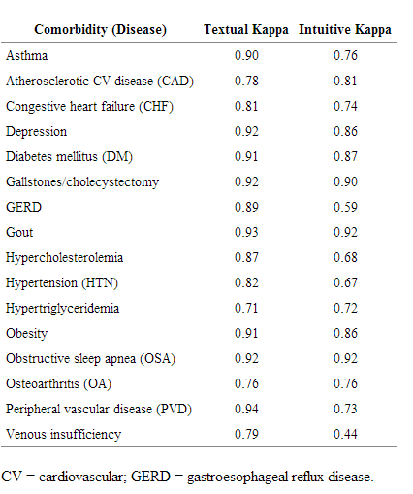
What did we work with?
The 2008 Obesity Challenge data set consists of 1237 patient discharge records written by medical professionals describing the health history and procedures done to the patient during their stay.
These records have been classified with certain diseases, or co-morbidities.
A patient diagnosed with depression could also be diagnosed with gout and/or diabetes.
A disease is classified as Present, Absent, Unmentioned or Questionable.
There are two types of annotations as well, textual or intuitive
Each record has been annotated by medical professionals with an average 72% kappa agreement.

Slide 5
Why did we choose to work on this?
To explore the use of subjective language in medical text with the goal of better identifying hidden patterns of sentiment that correlate to the diagnosis.
To our knowledge, sentiment analysis in the medical domain hasn’t been explored.
This data is produced by humans, even with the goal of being objective, subjective descriptions might exist.
Another topic, identifying sarcasm in the medical domian.

Slide 6
How we did it
Downloaded the data from i2b2.org. (XML documents)
Built a data warehouse for storage and analysis
Storage and “slicing and dicing” the data was done in MySQL
ETL was done in Python, Perl, and R
Stanford NLP Parser
Classification tools were
Python SKLearn (Random Forest, MaxEnt)
Mallet (MaxEnt)
Feature selection and modification was done in Python.

Slide 7
Python / Python / R
Extracted the text documents (with their IDs) from the XML files into the database
Converted the text documents into POS tagged sentences.
Extracted the entire instance for evaluation.
Extracted small subsections of text that contained fewer medical ontology words.
Uploaded Subjective Lexicon:
http://mpqa.cs.pitt.edu/lexicons/subj_lexicon/
Loaded data from the database into python for transformation

Slide 8
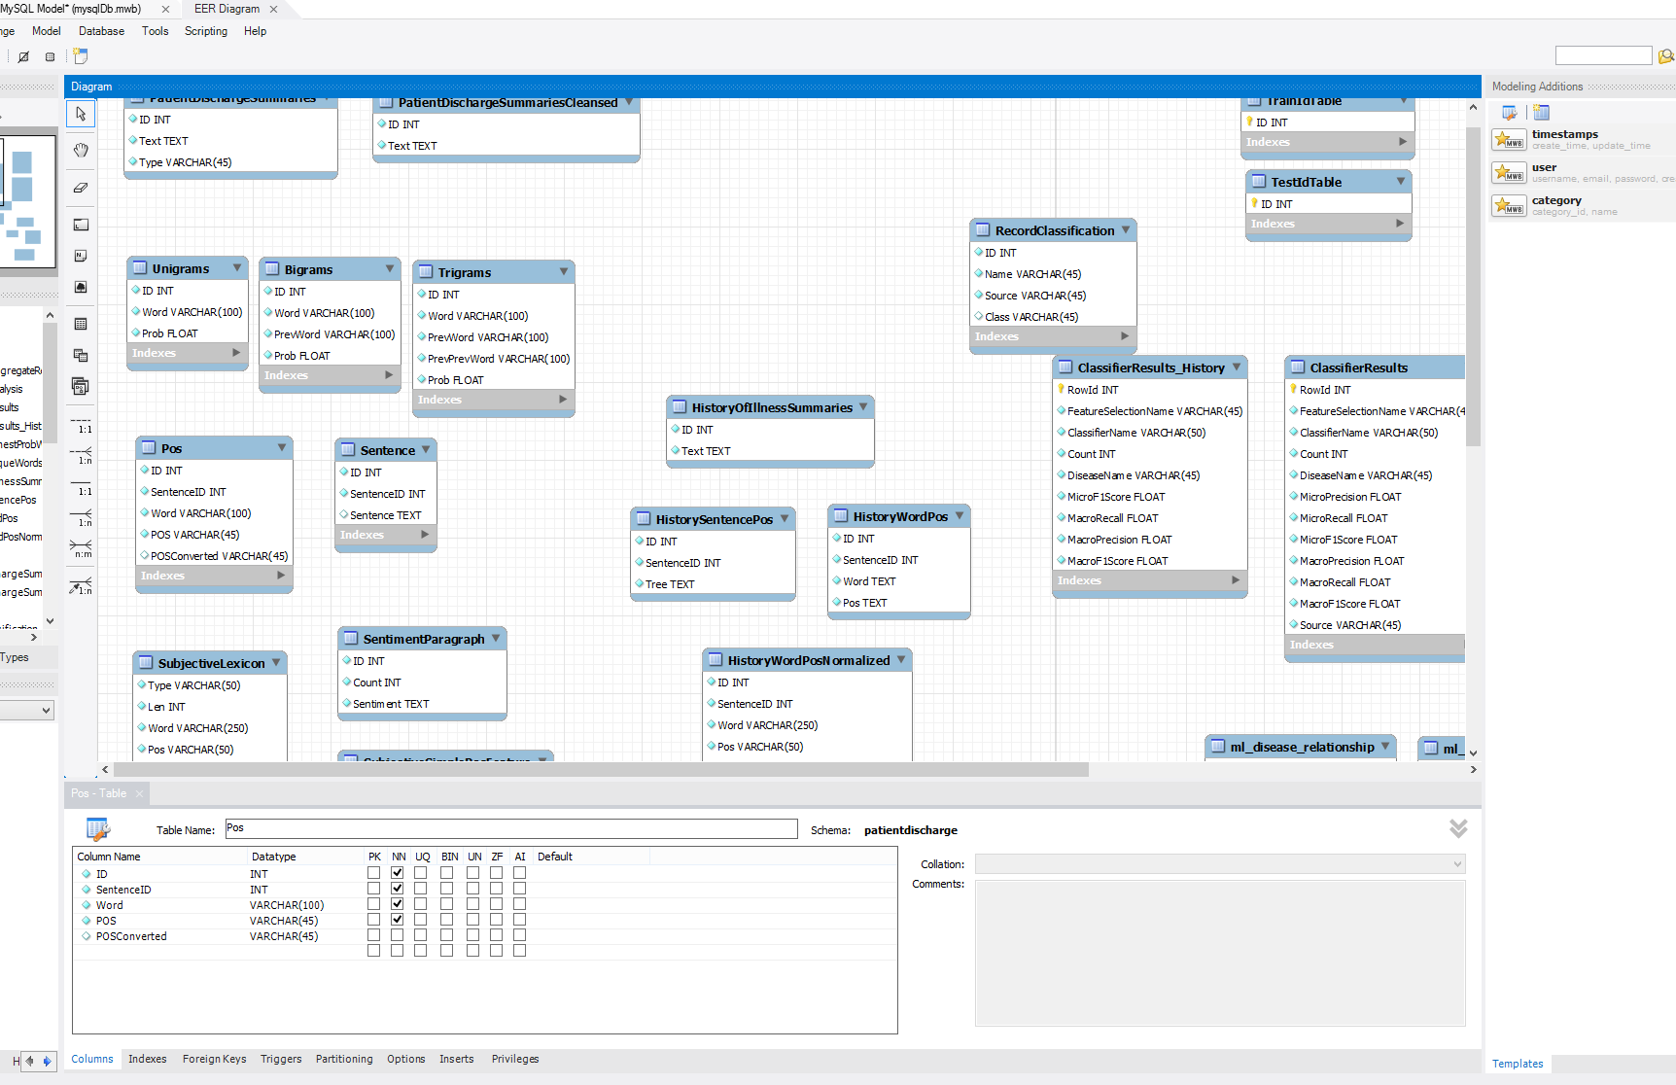
MySQL
O(log(n)) searching
Open source, hardened community
SQL is the lingua franca of data
Hosted from my house

Slide 9
Machine Learning
With the data in the database, separated out the training and the test instances.
Trained instances with several features
Custom Word Count feature.
Subjective Sentiment Simple
Positive / Negative based on word / pos
Subjective Sentiment Complex
Positive / Negative with strong/weak polarity on word / pos
Subjective Sentiment Word
Subjective Sentiment Word Polarity
Unique Words
Highest Probability Words

Slide 10
Results
Will compile by tonight

